Slide 1
REVIEW SITUATION PICK-UP SAMPLING & RETURN PRODUCT AT OQC
1. Normal model
<Have serial no. Scan ID pallet at FA stock>
2. Special model
<Have not serial no. and can not scan ID pallet>
3. Normal model
<Have serial no. Scan ID pallet at FA line>
Case 1
Case 2
Pick-up sampling <Pallet have not scan ID pallet>
Pick-up sampling <Pallet had scan ID pallet>
Pick-up sampling <Pallet had scan ID pallet>
Return product to empty pallet at stock and judgment OK by put indication OK sheet
Return product to pallet had ID pallet <pallet took out sampling before> and chop OK to sheet pallet, put indication OK sheet
Return product to pallet <pallet took out sampling before> and chop OK to sheet pallet, put indication OK sheet
Return product to pallet had ID pallet <pallet took out sampling before> and chop OK to sheet pallet, put indication OK sheet
FA stock member scan ID pallet and transfer product to pallet ID same model or make new ID pallet
FA stock member transfer pallet OK to SCM stock

Slide 2
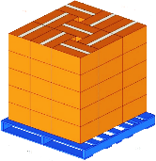
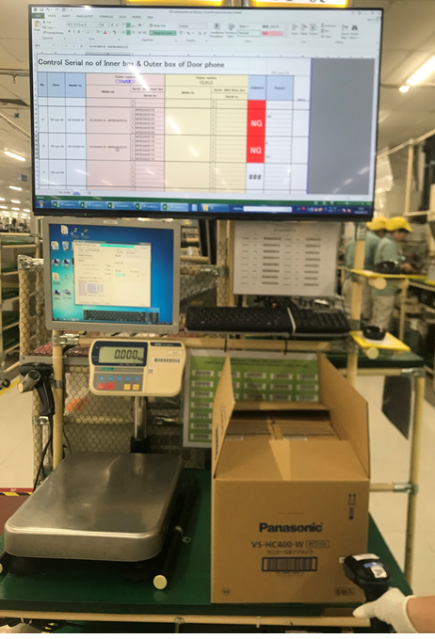
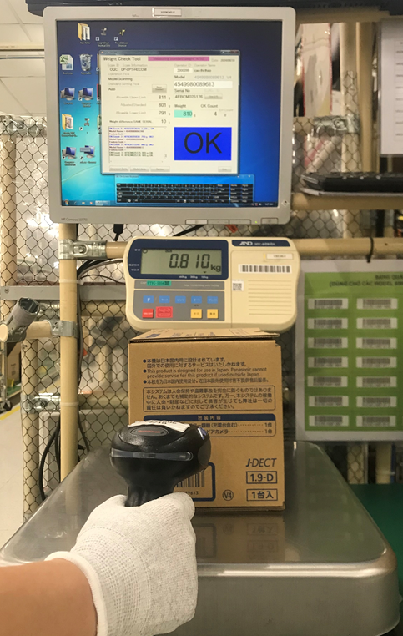
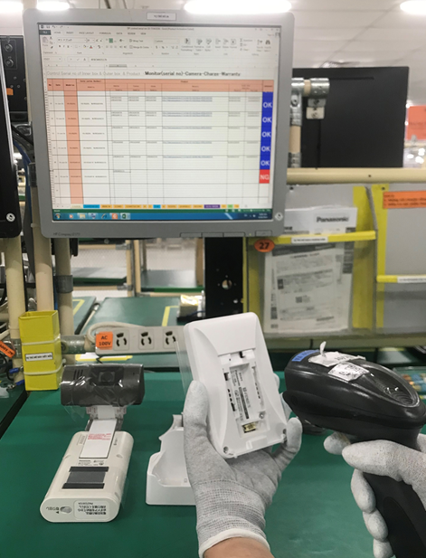
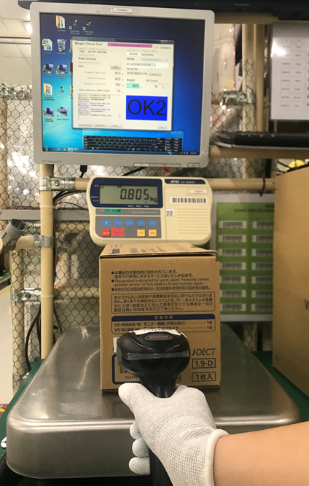
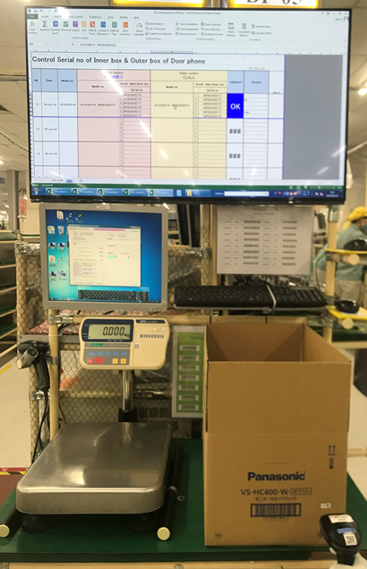
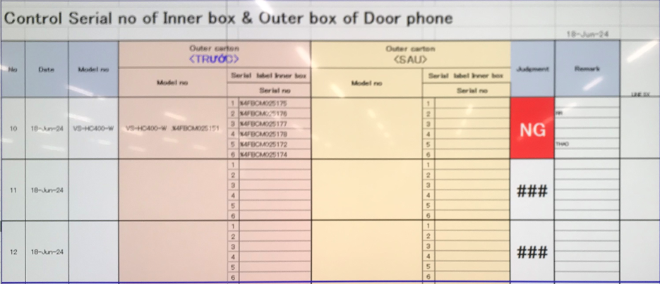
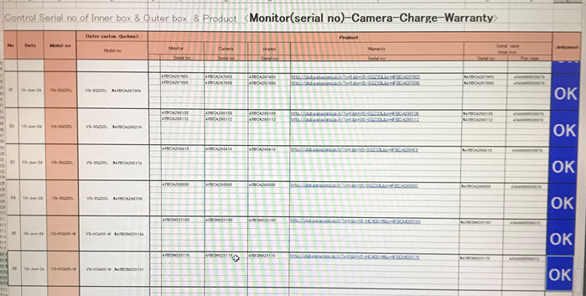
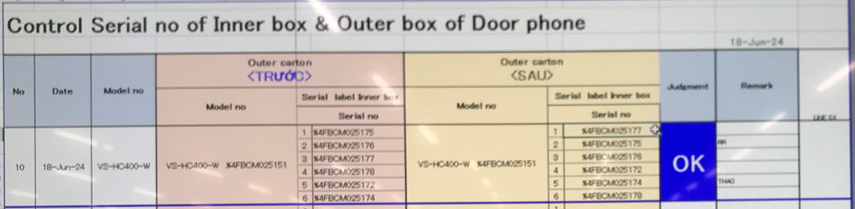
CONTROL PRODUCT PICK-UP SAMPLING AT OQC
Case 1:
1. Appearance check→
2. Function check 1st →
3. PL check→
4. Function check 2nd →
Case 2:
1. Appearance check →
2. Function check 1st →
3. PL check →
4. Characteristic check → 5. Specification check →
6. Function check 2nd →
OQC pick-up sampling from Stock FA
Scan ID outer box and serial inner box 1st to excel file “ID outer control sheet OQC”
Weight check 1st
Scan ID outer, scan serial <product, warranty, inner box> to excel file “Serial no. control sheet OQC”
Weight check 2nd
Scan ID outer box and serial inner box 2nd to excel file “ID outer control sheet OQC”
OQC return product to pallet FA stock and OK chop
Case 3:
1. Appearance check →
2. Function check 1st →
3. PL check →
4. Chamber test→
5. Function check 2nd →
Case 4:
1. Appearance check →
2. Function check 1st →
3. PL check
4. Drop test →
5. Vibration test→
6. Function check 2nd →
“ID outer control sheet OQC”
“Serial no. control sheet OQC”
“ID outer control sheet OQC”
Auto judgment OK
Auto judgment OK
OQC control product base on “ID outer control sheet OQC” & “Serial no. control sheet OQC” by auto judgment

